Slide 1
MACHINE FAULT DETECTOR
CAPSTONE PROJECT
Presented By:
1. P.SURYA PRAKASH-N.B.K.R.Institute of Science and Technology-ECE

Slide 2
OUTLINE
Problem Statement (Should not include solution)
Proposed System/Solution
System Development Approach (Technology Used)
Algorithm & Deployment
Result (Output Image)
Conclusion
Future Scope
References

Slide 3
Problem Statement
Develop a predictive maintenance model for a fleet of industrial machines to anticipate failures before they occur. This project will involve analyzing sensor data from machinery to identify patterns that precede a failure. The goal is to create a classification model that can predict the type of failure (e.g., tool wear, heat dissipation, power failure) based on real-time operational data. This will enable proactive maintenance, reducing downtime and operational costs..

Slide 4
Proposed Solution
The proposed system aims to address the challenge of predicting machine faults before failure occurs in an industrial environment. This involves leveraging machine learning and sensor data analytics to enable proactive maintenance and reduce operational downtime. The solution consists of the following components:
Data Collection:
Gather historical data from industrial machines, including temperature, torque, rotational speed, tool wear, and machine type.
Data Preprocessing:
Clean and preprocess data to handle missing values, normalize numeric features, and encode categorical ones.
Machine Learning Algorithm: Use a classification algorithm such as Random Forest or XG Boost to predict fault categories like tool wear failure, heat dissipation, or power failure.
Model Deployment: Deploy the model on IBM Watson Machine Learning. Accept CSV inputs and return predictions along with class-wise probabilities.
Visualization: Provide predictions in table view and multiclass classification chart (pie + bar) for better interpretation.
Evaluation: Assess model accuracy using confusion matrix, precision, recall, and F1-score. Tune model for optimal performance.
Result.

Slide 5
System Approach
SYSTEM APPROACH – Machine Fault Predictor
System requirements:
IBM Cloud Lite account (free tier)
IBM Watson Studio with Auto AI enabled
Web browser with stable internet connection
Dataset in CSV format for training and testing
Deployment space in IBM Cloud for model hosting
Libraries required to build the model:
No coding libraries needed Auto AI handles preprocessing, feature engineering, model selection, and evaluation automatically
IBM Watson Machine Learning used for deployment and prediction
Optional: IBM Cloud Object Storage (for storing datasets and assets)

Slide 6
Algorithm & Deployment
Algorithm Selection:
Auto AI automatically selected the best classification algorithm based on model evaluation metrics. In our case, the chosen algorithm was a Random Forest Classifier, which performed best in predicting failure types.
Data Input:
Sensor data such as:
Air temperature
Process temperature
Rotational speed
Torque
Tool wear
Machine type were used as input features to predict different machine failures (e.g., tool wear, heat dissipation, power failure).
Training Process :Auto AI split the dataset into training and validation sets.
Feature scaling, encoding, and hyperparameter optimization were done automatically. The best pipeline was selected based on accuracy and F1-score.
Prediction Process: The deployed model accepts test data in CSV format.
Predictions are shown as class labels (failure type) with probability scores for each class.

Slide 7
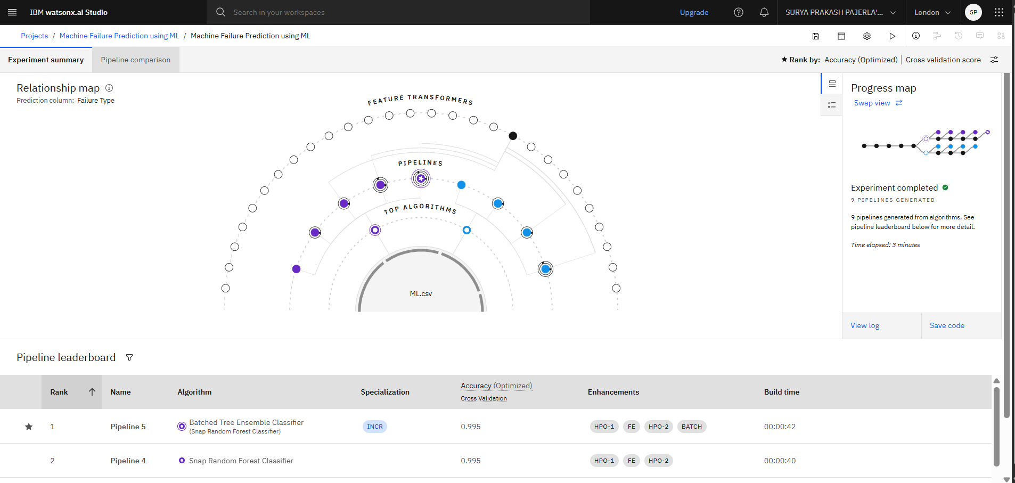
Result

Slide 8
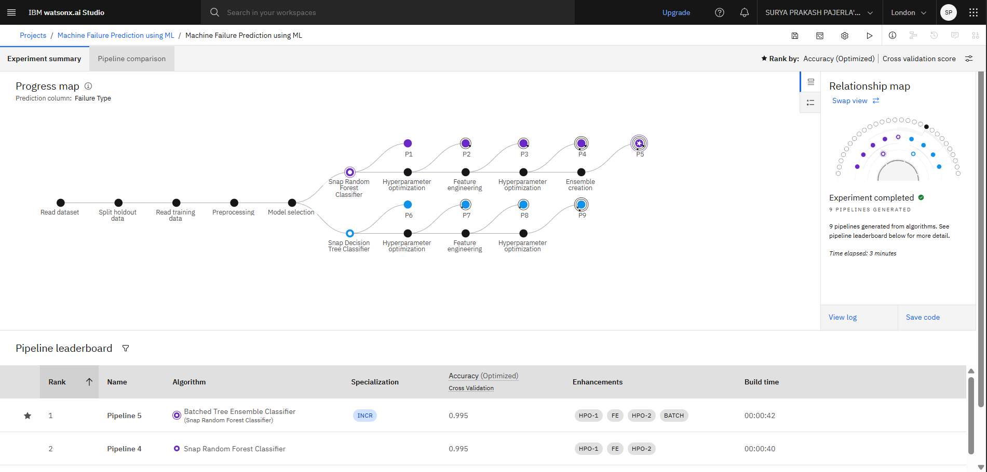
Result

Slide 9
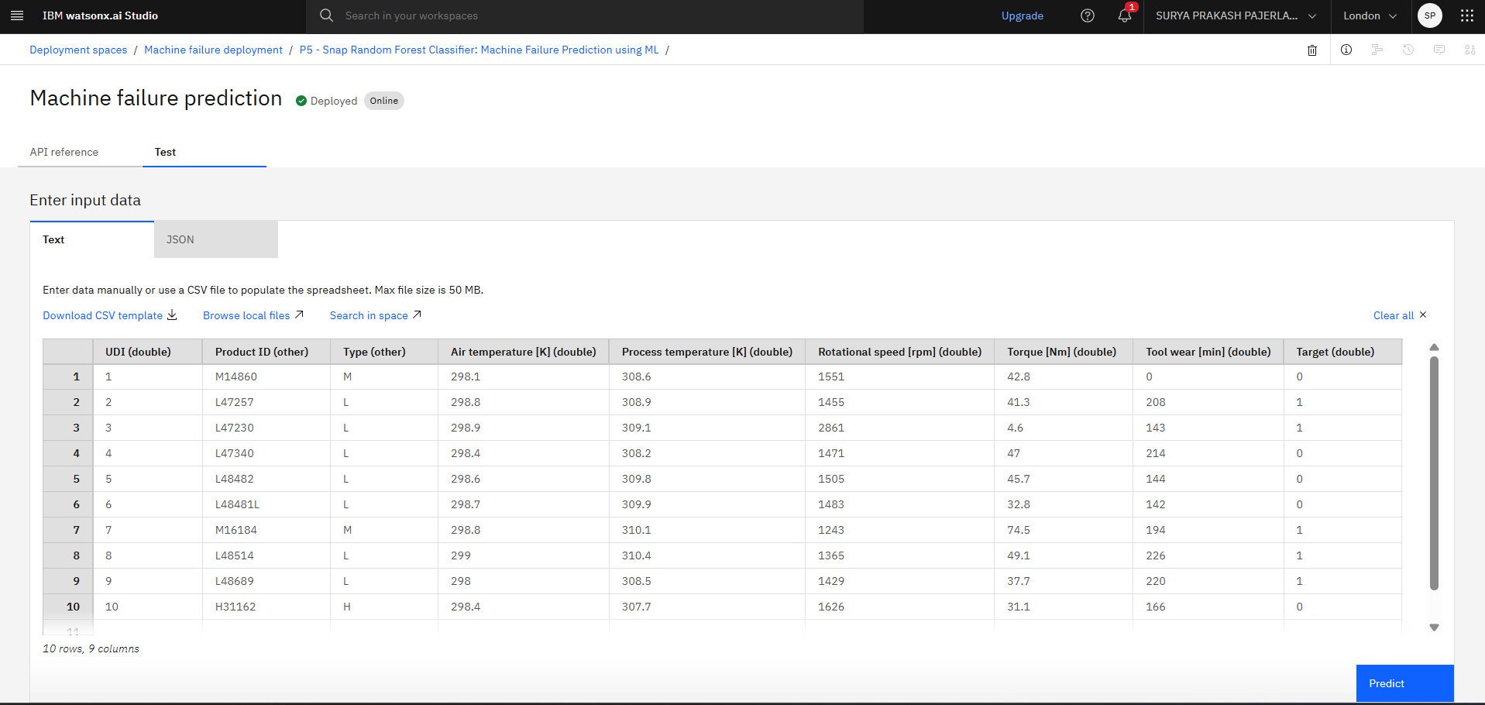
Result

Slide 10
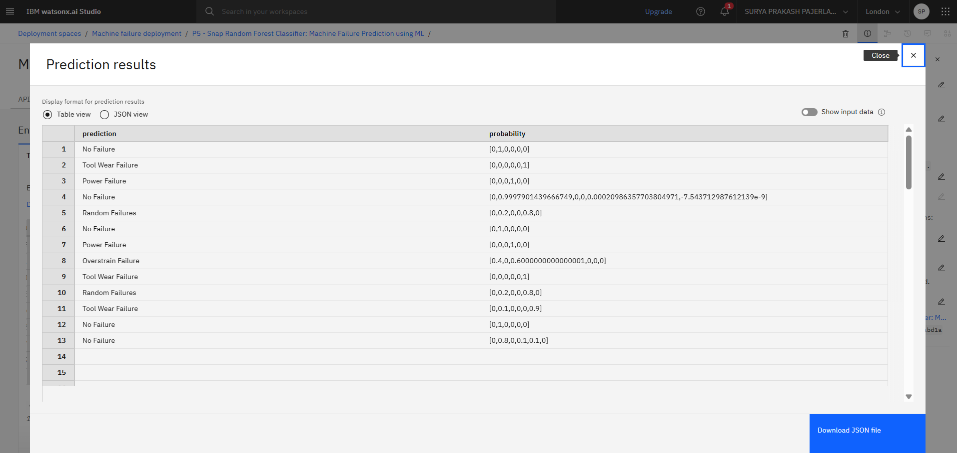
Result

Slide 11
Conclusion
A machine learning model was successfully developed using IBM AutoAI to predict different types of industrial machinery failures based on sensor data.
The system effectively classifies failure types such as tool wear, heat dissipation, and power failure, enabling timely and preventive maintenance actions.
The no-code Auto AI platform simplified model training and deployment, making the solution accessible to non-programmers.
Deployment on IBM Cloud ensures scalability, real-time access, and ease of integration into industrial workflows.
The solution helps industries reduce unplanned downtime, extend machine life, and minimize maintenance costs through proactive fault detection.
Overall, the project demonstrates how AI-powered predictive maintenance can enhance operational efficiency in industrial environments.

Slide 12
Integrate real-time sensor data streaming from IoT-enabled machines to allow continuous fault monitoring
.Expand the model to predict remaining useful life (RUL) of machine components for better maintenance planning.
Incorporate additional parameters like vibration or sound analysis to enhance prediction accuracy.
Enable mobile app or dashboard-based alerts for fault detection and maintenance scheduling.
Train the model with a larger and more diverse dataset to improve generalization across different machine types.
Use edge computing for on-device predictions in remote or bandwidth-limited industrial settings.
Combine predictive maintenance with prescriptive recommendations for optimal repair actions.
Future scope

Slide 13
References
Predictive Maintenance Dataset from Kaggle
IBM Watson Studio Documentation
IBM Watson Machine Learning Documentation
IBM Auto AI Overview
Scikit-learn Library Documentation
Shivam Bansal, Predictive Maintenance Data, Kaggle, 2020.

Slide 14
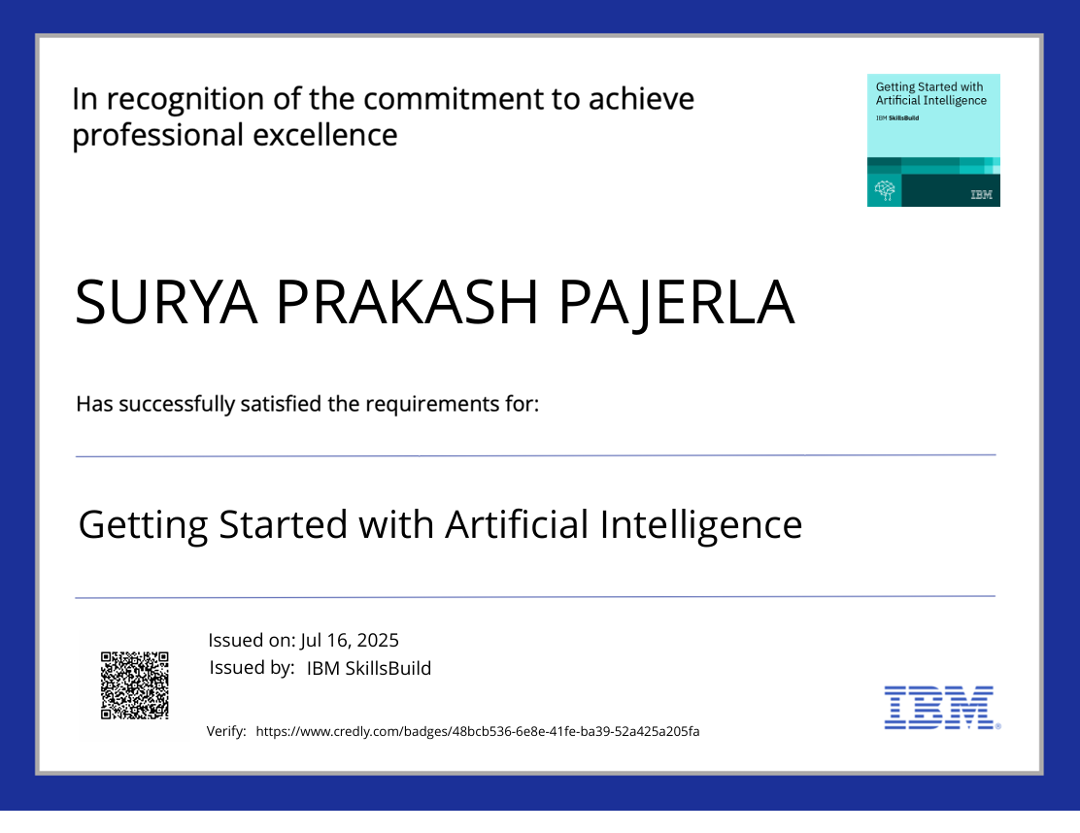
IBM Certifications

Slide 15
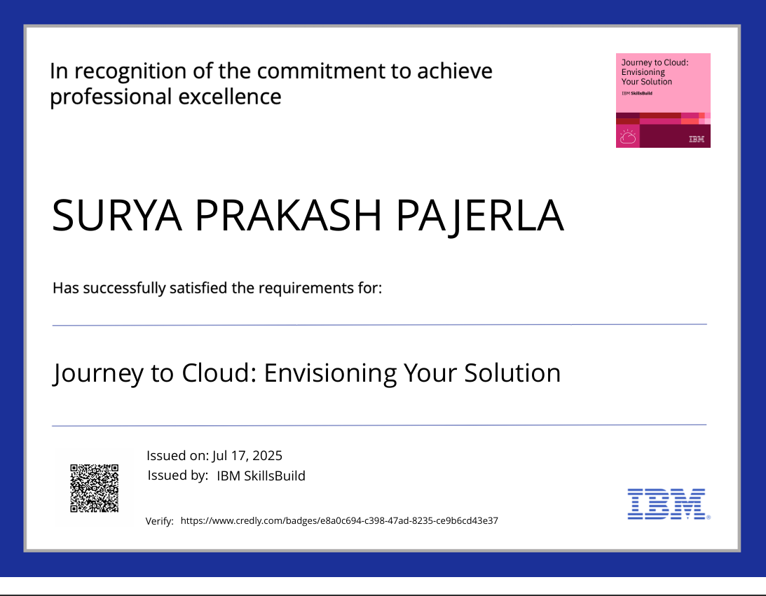
IBM Certifications

Slide 16
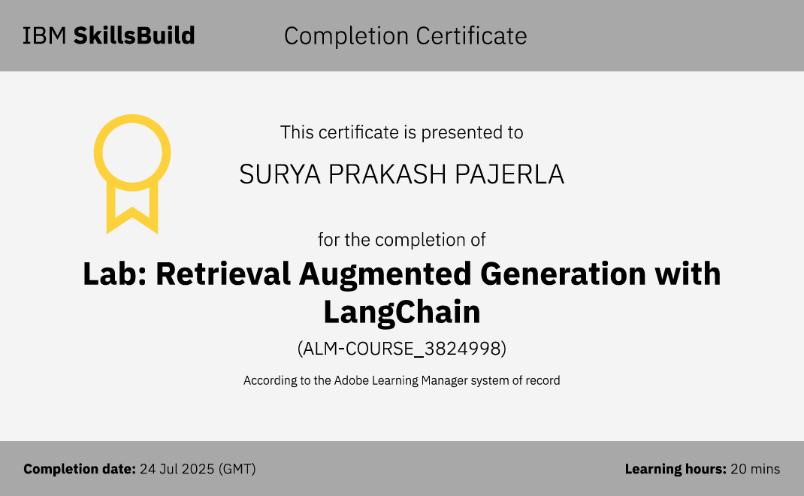
IBM Certifications

Slide 17
THANK YOU

